Slide 1

SPONSORSHIP OPPORTUNITY
SmartTicket AI
Intelligent Support. Zero Friction.
An AI-powered ticketing platform that understands your employees, routes requests automatically, and keeps every team informed — in real time.

Slide 2
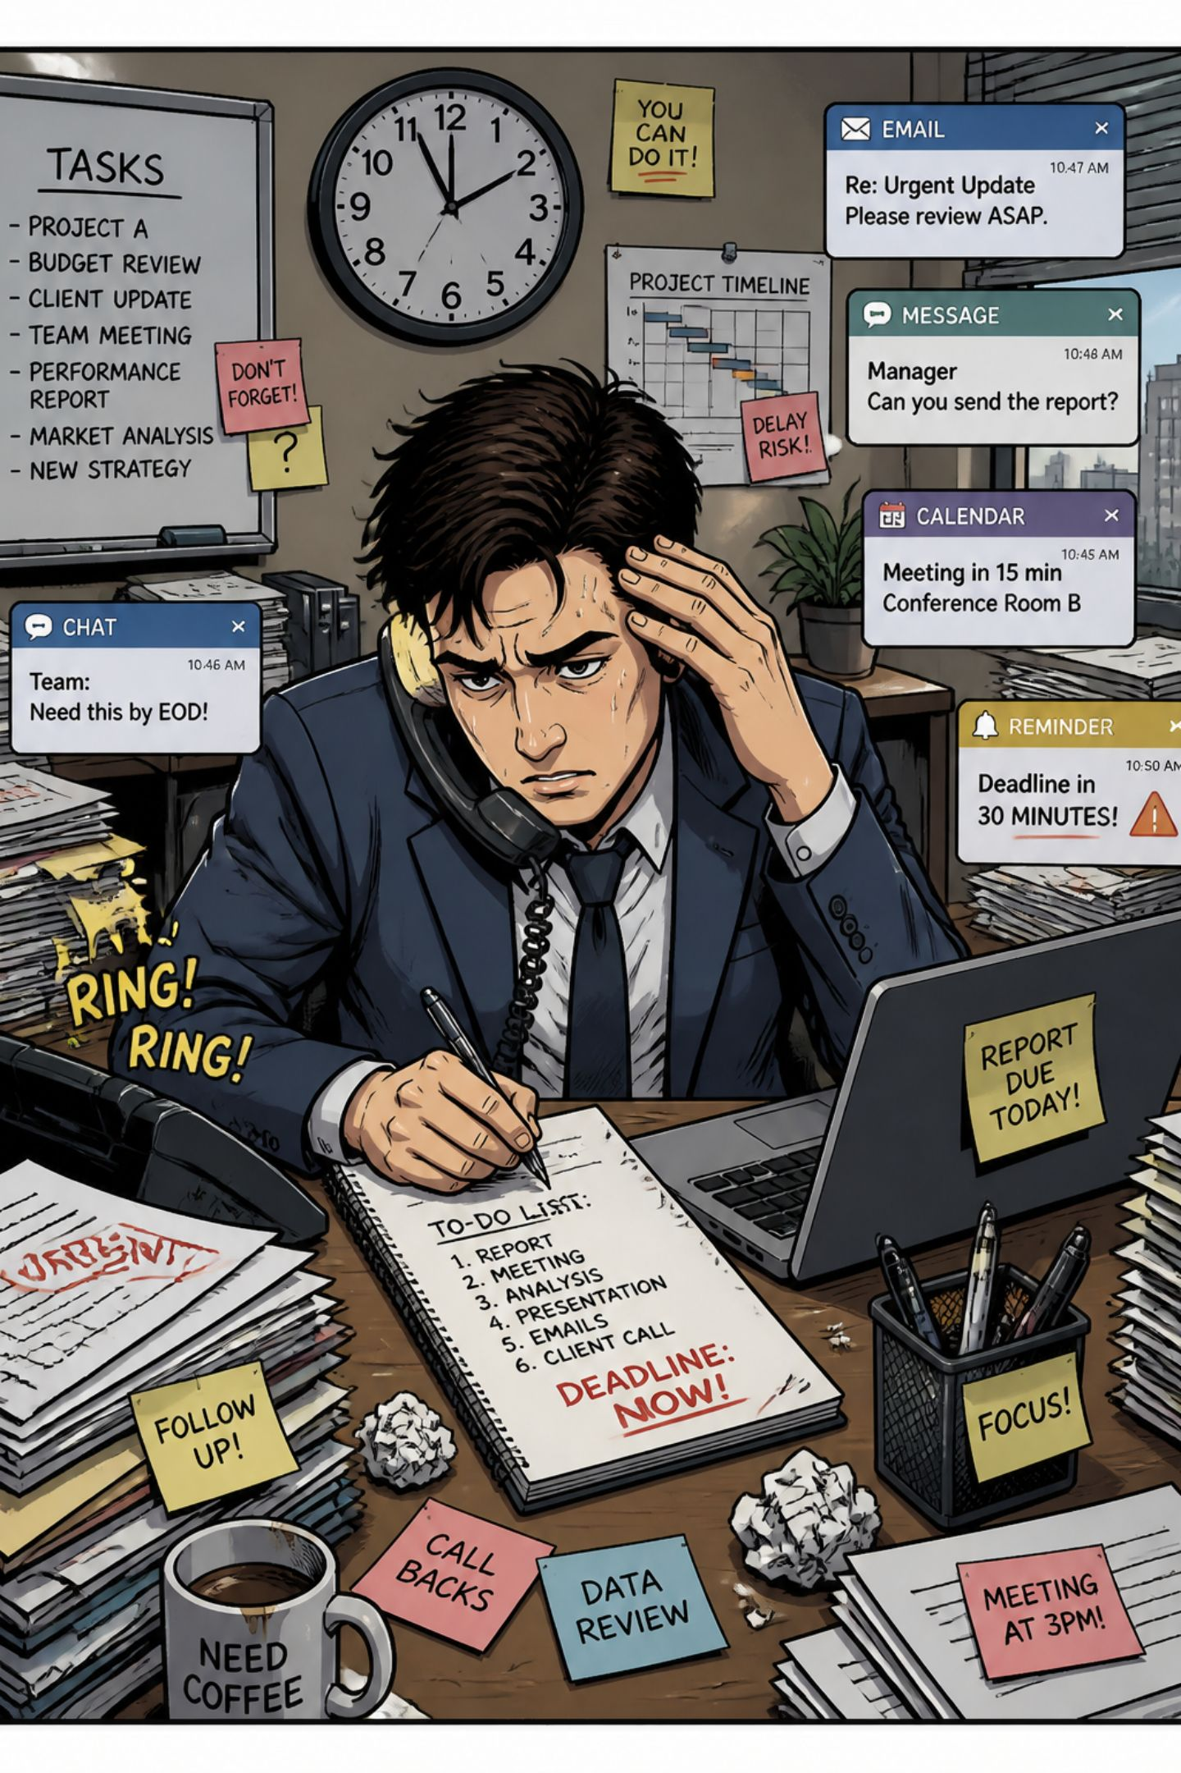
THE PROBLEM
Manual Ticketing Is Costing You Time and Accuracy
Misrouted Requests
Administrative Overload
Employees choose the wrong department, causing delays and frustration.
Support staff spend hours manually sorting and reassigning tickets.
No Visibility
Without tracking or history, recurring issues go unnoticed and unresolved.

Slide 3
Eight-Week Sprint Execution Roadmap
Eight sprints evolved the platform from foundational architecture to intelligent enterprise automation.
Weeks 1–2
Weeks 5–6
Week 8
Project scoping, Firebase environment setup, and core architecture design, next.js frontend build and Firestore schema definition
Add Predictive Insights and Compliance Status feature
Production deployment, validation testing, and documentation
1
2
3
4
5
Weeks 3–4
Week 7
Data tracking & analytics module, Weekly Business Report
Automated routing, email alerts, and multi-stage approvals

Slide 4
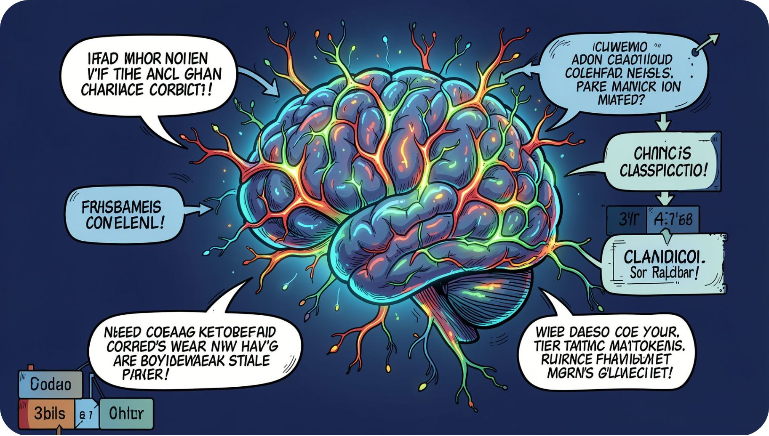
CORE INTELLIGENCE
AI That Understands, Not Just Keywords
Natural Language Processing
Employees describe issues in plain English. SmartTicket AI understands intent and context — not just keywords — making it accessible to everyone.
AI-Powered Classification
The system analyses each complaint and automatically identifies the most appropriate department, eliminating manual routing entirely.
Confidence Score
Every classification includes a confidence indicator, helping administrators decide whether to review a ticket before processing.

Slide 5




SMART ROUTING
Every Request Reaches the Right Team — Instantly
IT
Human Resources
Technical issues, hardware requests, and system access routed automatically.
Leave requests, policy questions, and onboarding handled without delay.
Finance
Operations
Expense claims, invoicing queries, and budget approvals directed correctly.
Facilities, logistics, and general operational requests reach the right team.

Slide 6
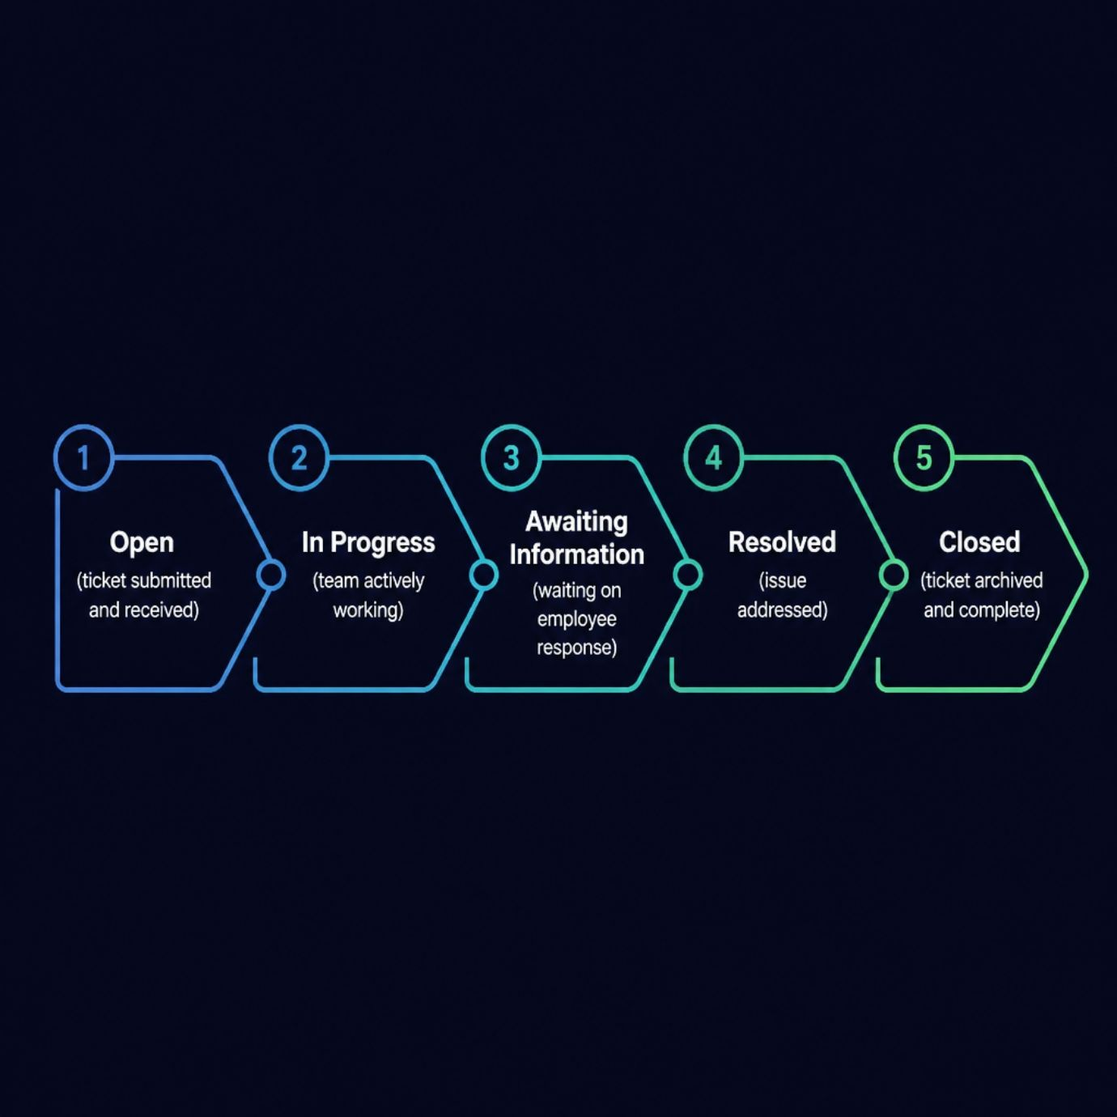
AWARENESS & CONTROL
Tone Detection, Status Tracking & Notifications
Tone & Urgency Detection
SmartTicket AI identifies whether a ticket is formal, friendly, or urgent — enabling departments to prioritise critical issues before they escalate.
Ticket Status Tracking
Employees and admins monitor progress through clear stages: Open → In Progress → Awaiting Information → Resolved → Closed.
Email Notifications
Automated alerts keep everyone informed at every stage — submission, assignment, status changes, and resolution.

Slide 7
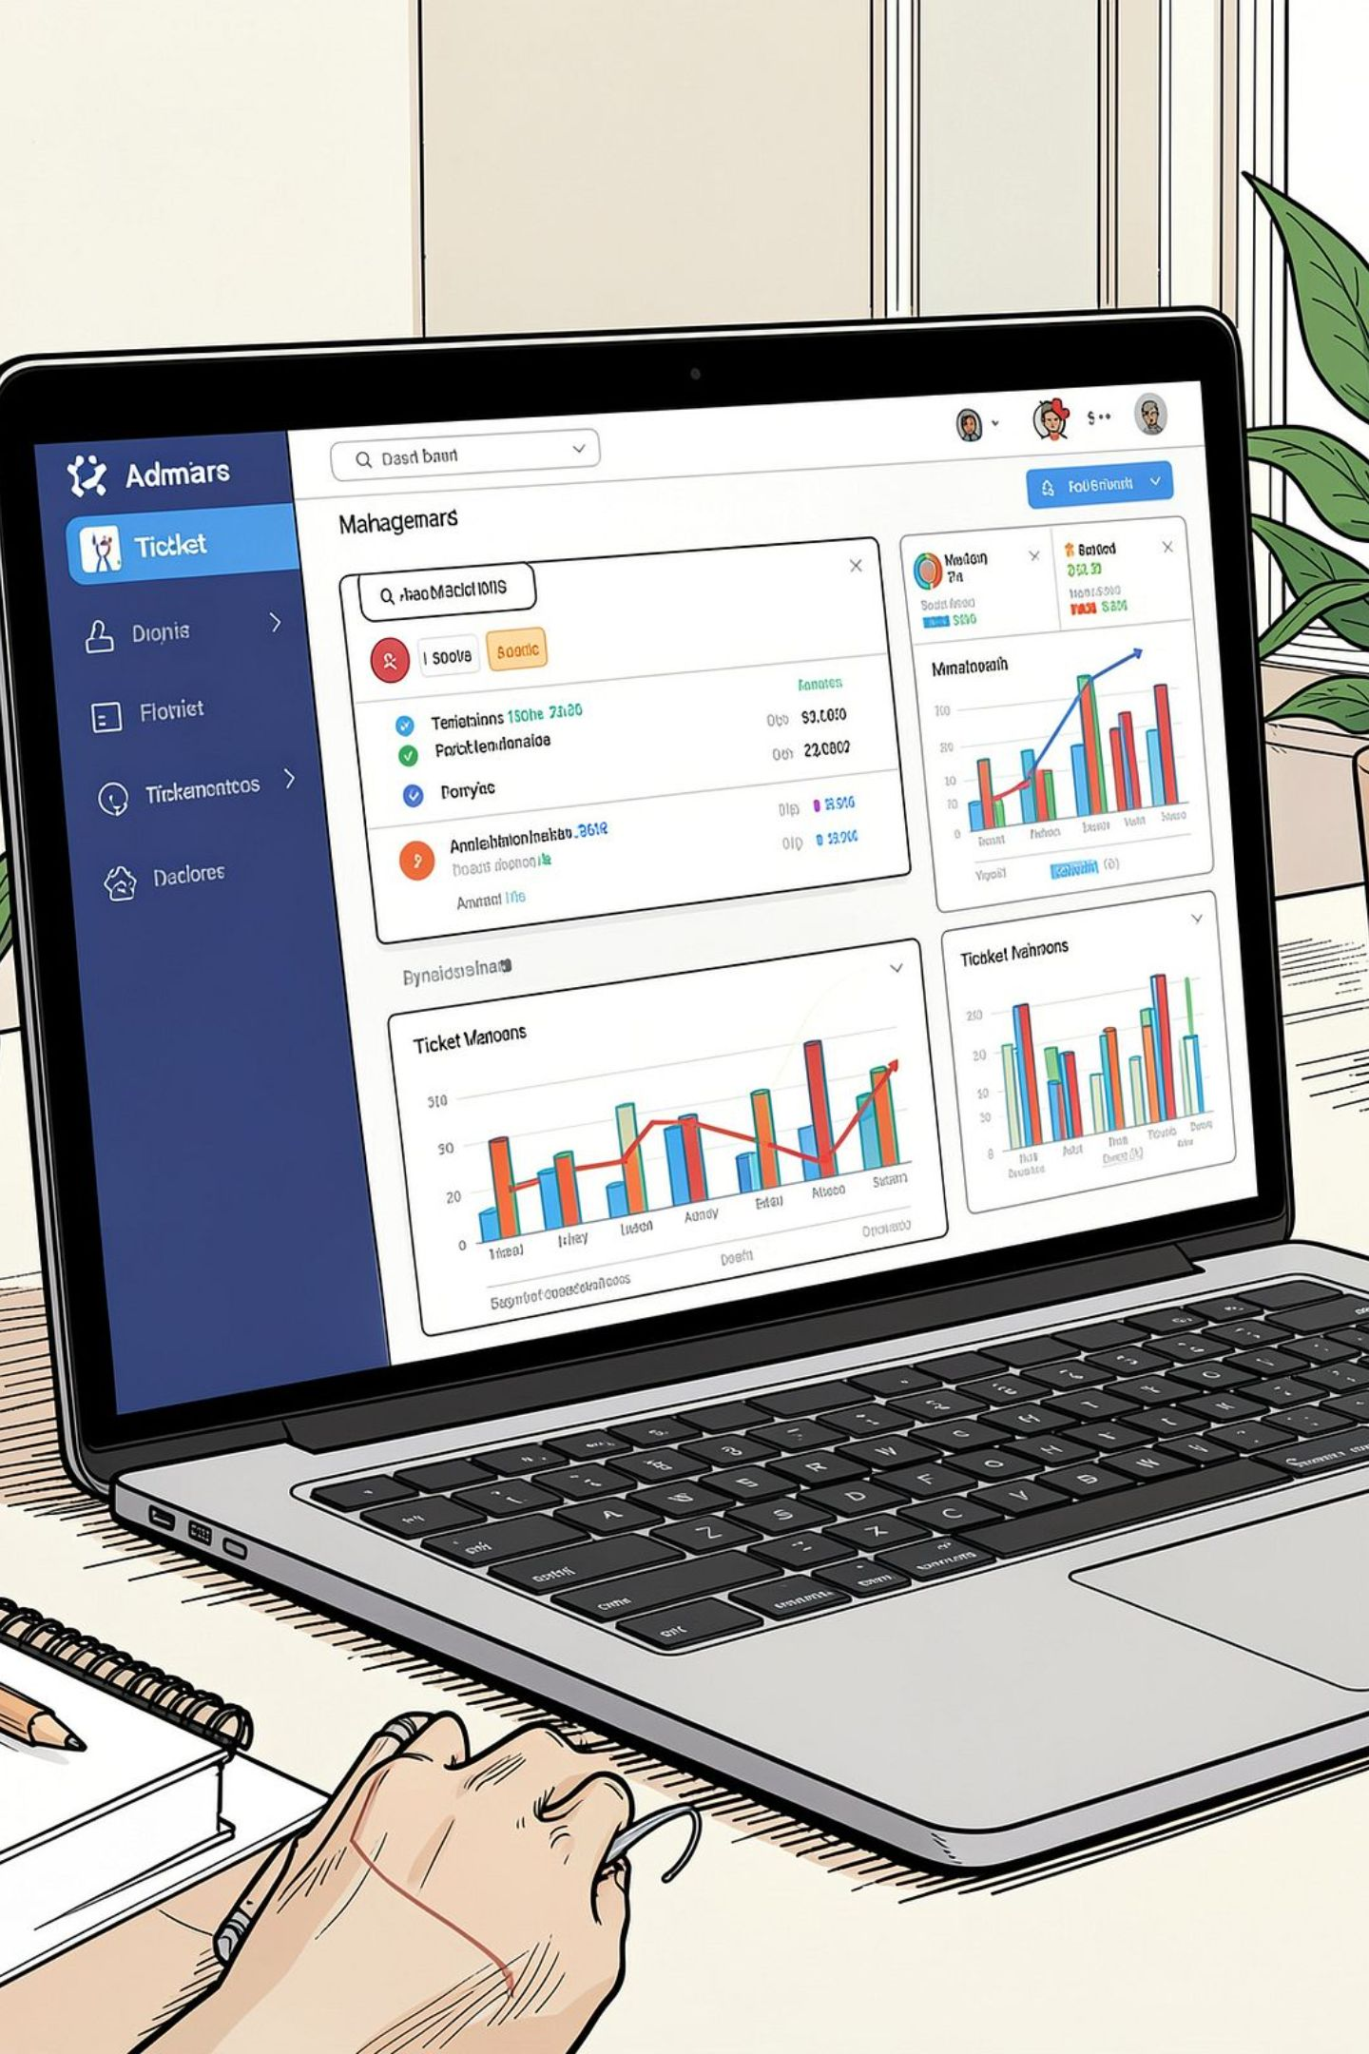




ADMIN CONTROL
One Dashboard. Complete Oversight.
Centralised Ticket View
View all submitted tickets, filter by department, and monitor live statuses from a single interface.
AI Confidence Review
Review low-confidence classifications before processing, ensuring accuracy where it matters most.
Searchable Ticket History
Maintain a complete, organised record of all requests — making it easy to identify recurring issues and measure team performance over time.
Manage & Update
Assign, reassign, and update tickets in real time with full audit trails stored securely in Firebase Firestore.

Slide 8
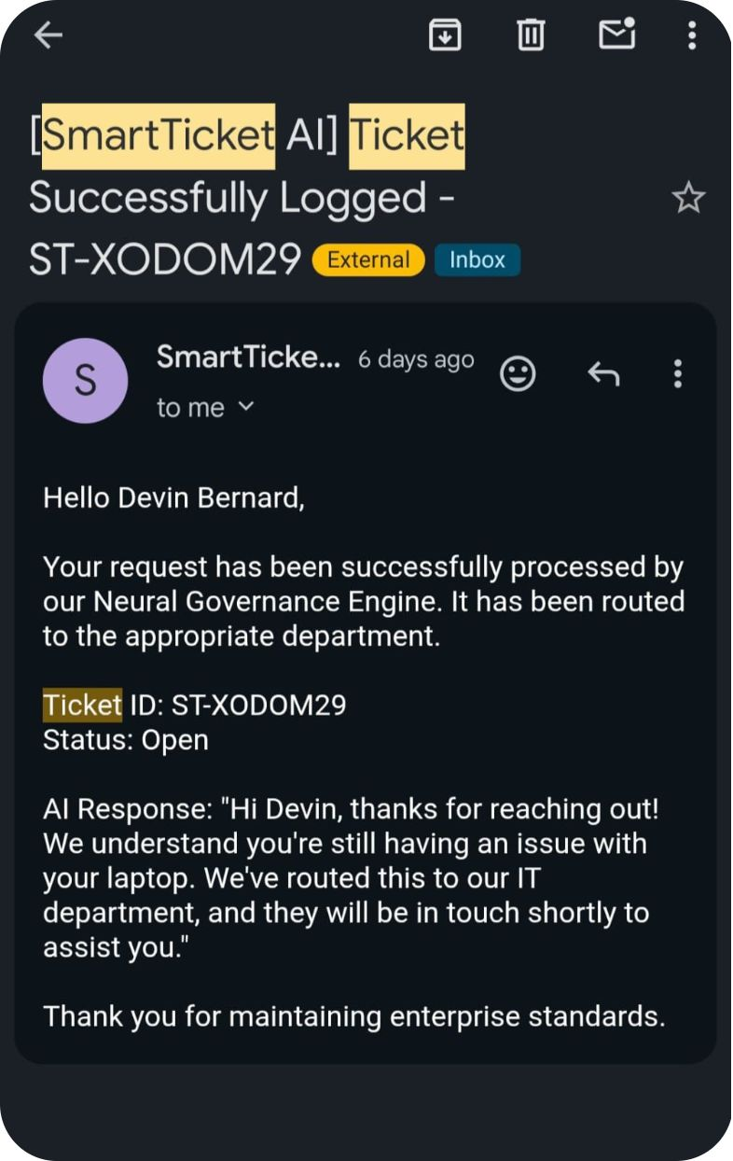
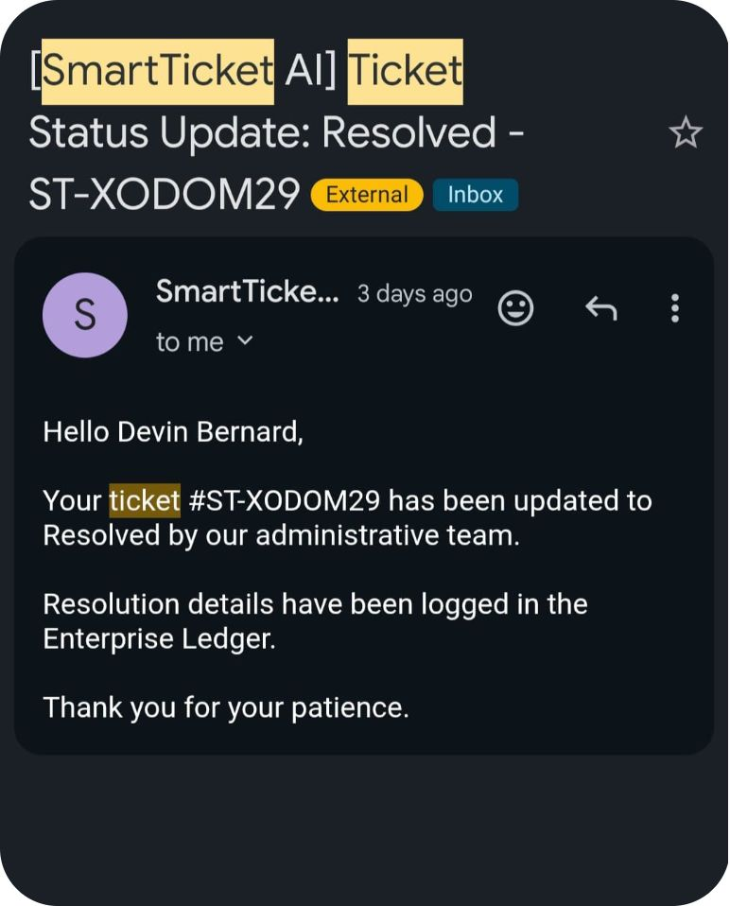
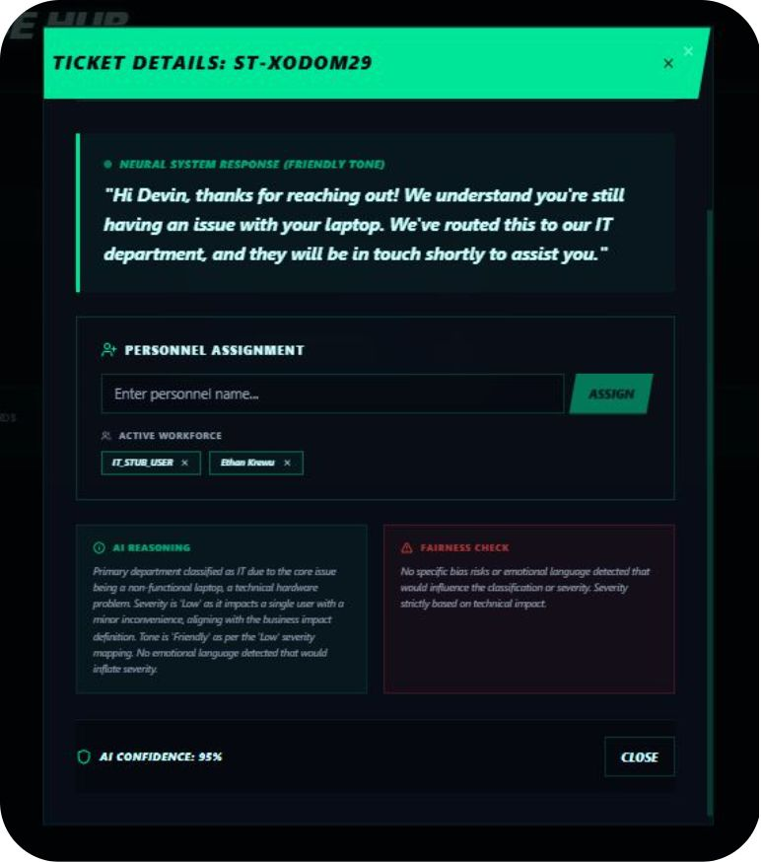

Slide 9

BUSINESS IMPACT
Measurable Gains From Day One
0
4
Manual Sorting Steps
Departments Covered
AI eliminates ticket categorisation workload entirely.
IT, HR, Finance, and Operations — all connected from one platform.
5
24/7
Status Stages
Real-Time Updates
Full lifecycle tracking from submission to resolution.
Firebase Firestore ensures instant sync across all users and devices.
SmartTicket AI reduces human error in ticket assignment, shortens resolution times, and frees support staff to focus on solving problems — not sorting them.

Slide 10

SPRINT 8
Week 8 – Deployment & Optimisation
The final sprint focuses on refining, optimising, and deploying the completed AI Business Operations Platform to ensure a seamless launch.
01
02
Application Deployment
System Testing & Resolution
Deploy the platform to a secure cloud hosting environment.
Conduct comprehensive system tests and address any remaining issues or bugs.
03
04
Performance Optimisation
Integration Verification
Enhance application performance, reliability, and overall user experience.
Confirm full integration and functionality of AI, databases, and external APIs.
Expected Outcome: A secure, stable, and production-ready AI Business Operations Platform, accessible via a live deployment.

Slide 11





WHAT'S NEXT
Built for Scale. Designed for the Future.
Voice Submission
Submit tickets by speaking — ideal for mobile and accessibility.
Multilingual Support
Break down language barriers with AI-powered translation.
WhatsApp Integration
Submit and track tickets directly through WhatsApp.
Enterprise Integrations
Connect with Microsoft 365, Jira, ServiceNow, and SAP.
Partner with us to shape the roadmap and bring SmartTicket AI to your organisation.

Slide 12
Thank You
We appreciate your time and attention today. Let’s connect to discuss how SmartTicket AI can transform your operations.
Notes:
Conclude by reiterating the core message: SmartTicket AI is built for a future of intelligent, friction-free support.
Open the floor for questions and provide contact information.
Express enthusiasm for potential collaboration.

